Slide 1
COMP-4441 Final Project
Navan Powers & Andrew Graham

Slide 2
Research Question
Did the “Stay-at-Home” lockdown orders due to the Covid-19 outbreak affect marijuana dispensary sales in Colorado?

Slide 3
Data Sources
Marijuana Sales Data
Colorado Department of Revenue
https://cdor.colorado.gov/data-and-reports/marijuana-data/marijuana-sales-reports
January 2014 – May 2021
Covid Incidence Data
Colorado Department of Public Health & Environment
https://covid19.colorado.gov/data
March 2020 – Present
Note: Marijuana dispensaries were classified as part of state’s Health Care Sector and allowed to remain open during lockdown orders

Slide 4
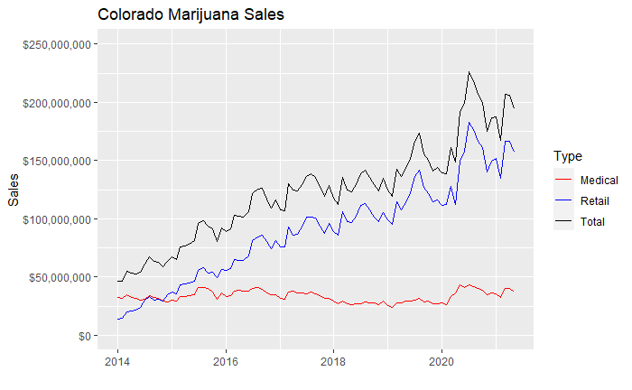
Initial Data Plot

Slide 5
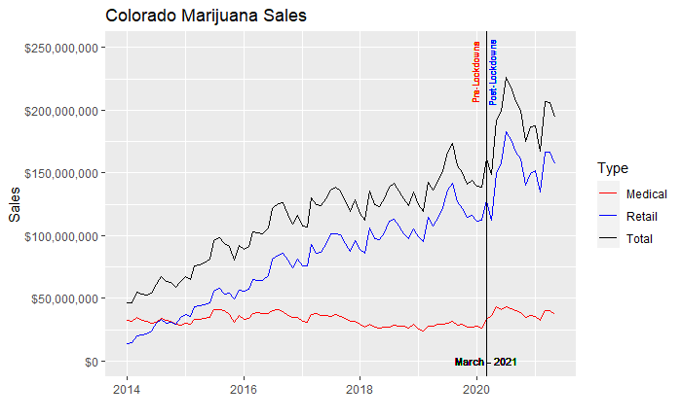
Initial Data Plot – Lockdown Marker

Slide 6
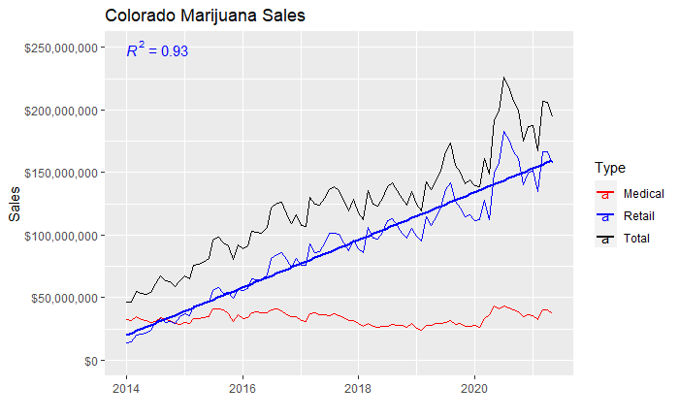
Linear Model over Retail Sales
Intercept: -816924375
Slope: 52076

Slide 7
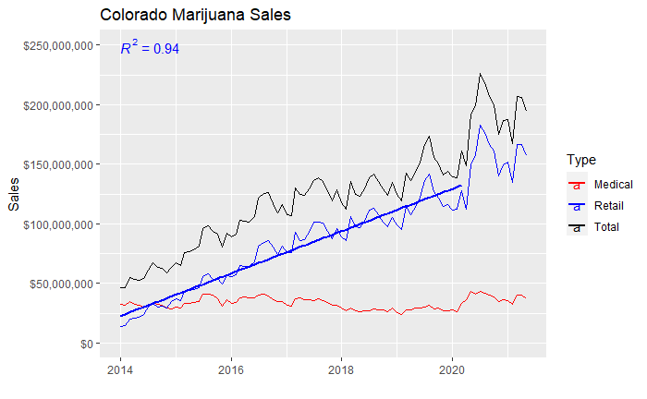
Linear Model over Retail Sales – Pre Lockdown
Intercept: -762643374
Slope: 48856

Slide 8
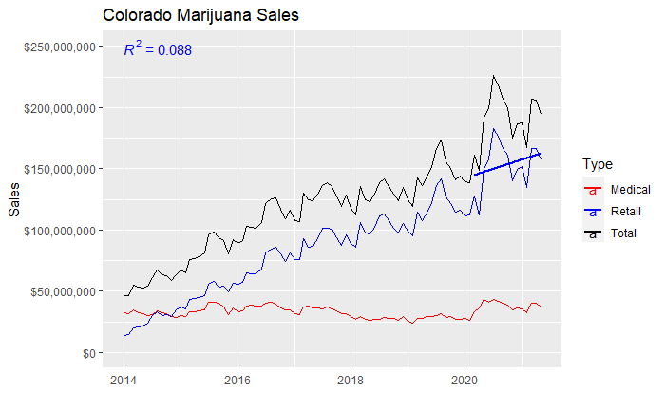
Linear Model over Retail Sales – Post Lockdown
Intercept: -604744878
Slope: 40915

Slide 9
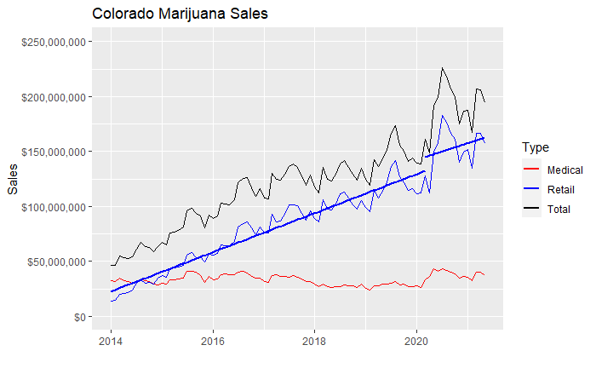
Combined Linear Models over Retail Sales

Slide 10
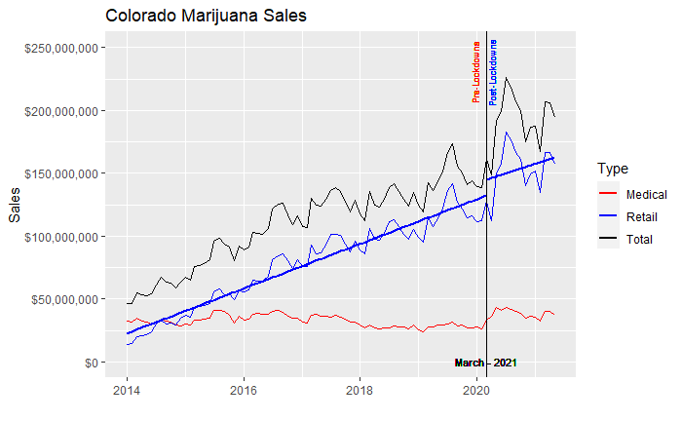
Stay-at-home Lockdown Marker

Slide 11
Chow Test – *WIP Text*
Structural break in data between two or more regressions
Used to determine if there is a structural break in data linearity between two or more regressions in split data sets
Test if single line or two separate regression lines best fit the data
Often times used to analyze two different data sets to see if they can be pooled together
Regression discontinuity
Commonly used in econometrics
Regression stability test
Returns p-value of regression stability

Slide 12
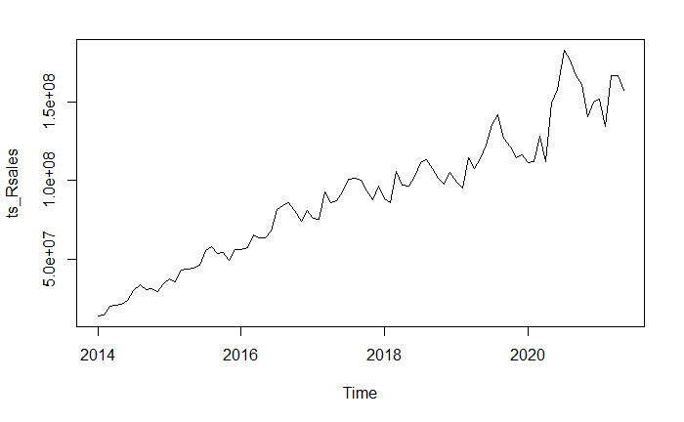
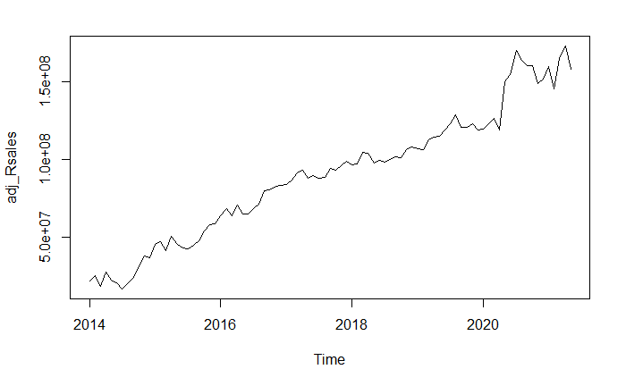

Removing Regular Fluctuation or Seasonality in Data

Slide 13
Sales with Lockdown Marker

Slide 14
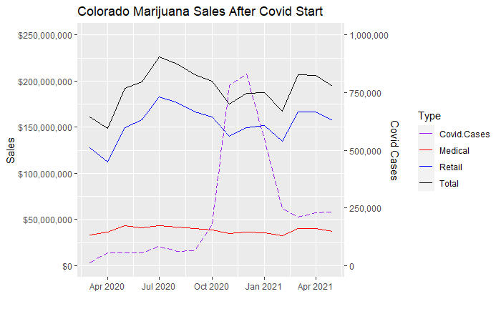
Retail Sales and Covid Cases

Slide 15
Conclusions - *WIP Text*
Evidence of change in marijuana sales trend before and after Covid-19 lockdowns
Lockdowns due to Covid-19 show more possible correlation to a deviation in marijuana sales trends than the actual cases of Covid do

Slide 16

Questions

Slide 17
END

Slide 18
Retail Sales and Covid Cases

Slide 20
